Slide 1

Member:
Beiyu Zhou, Ruikang Lin
Date: 2026/01/10

Slide 2
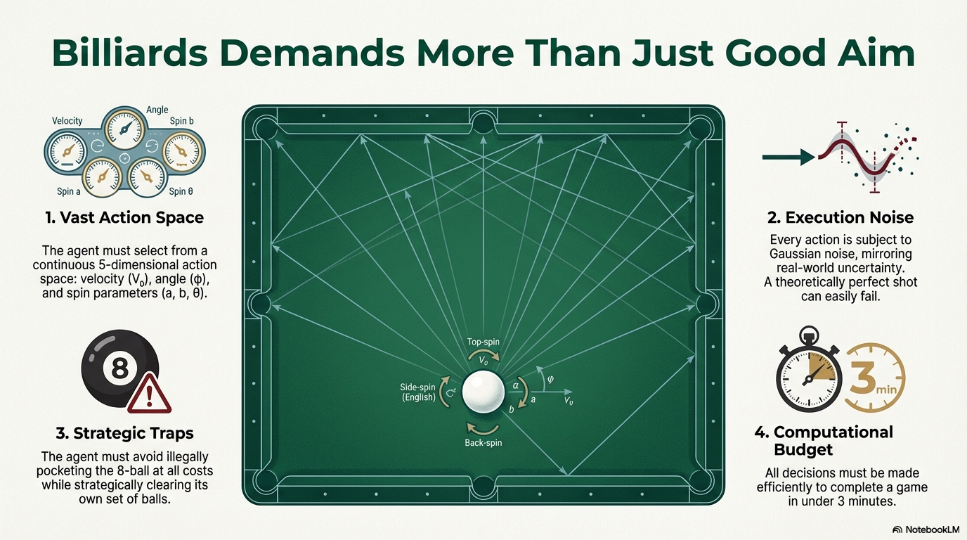

Slide 3
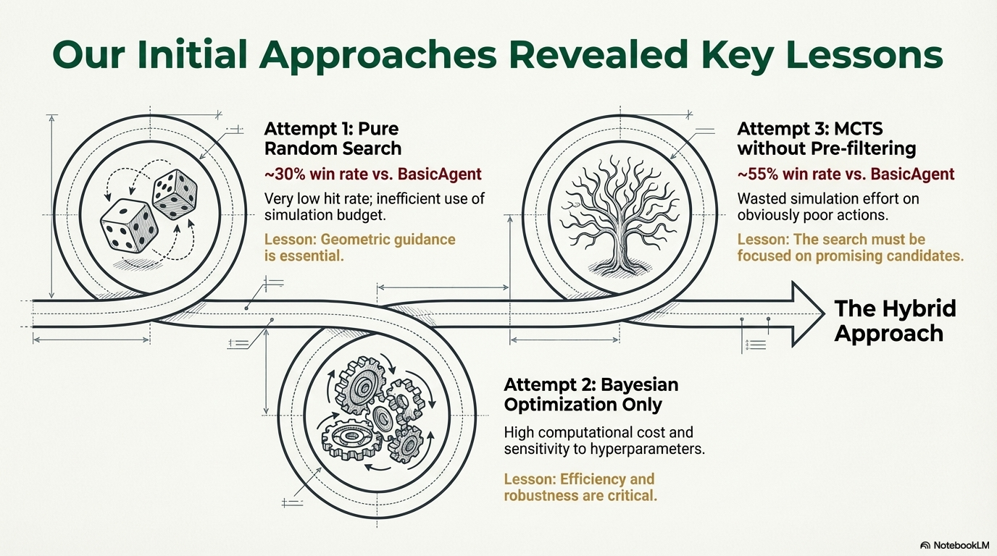

Slide 4
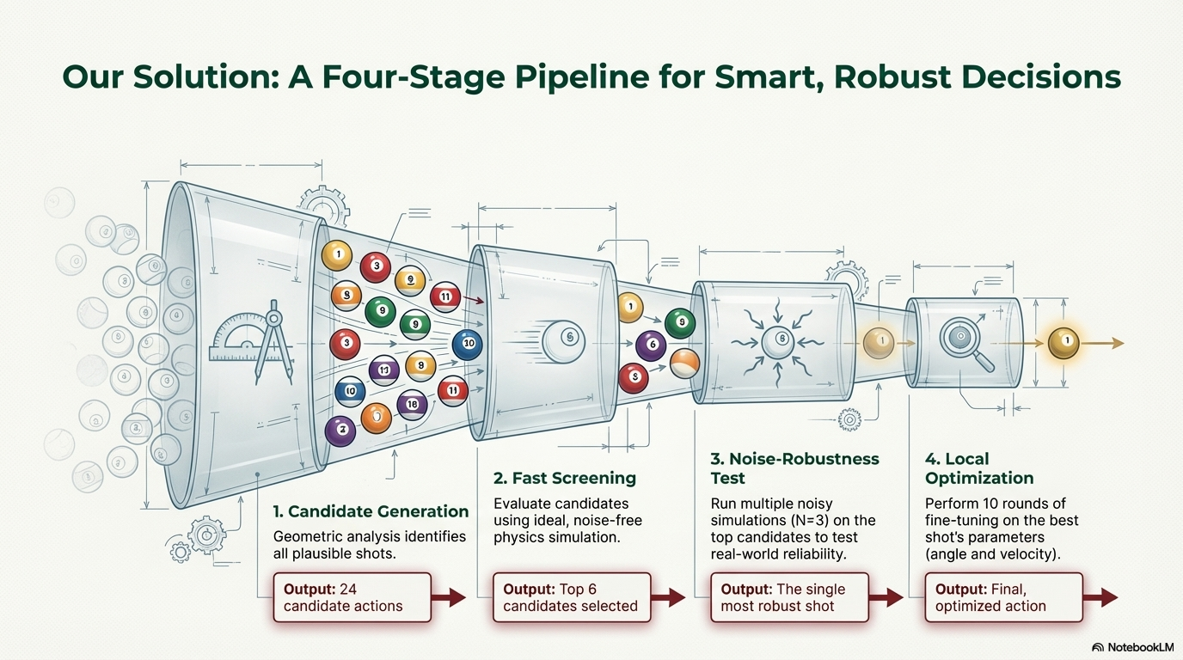

Slide 5
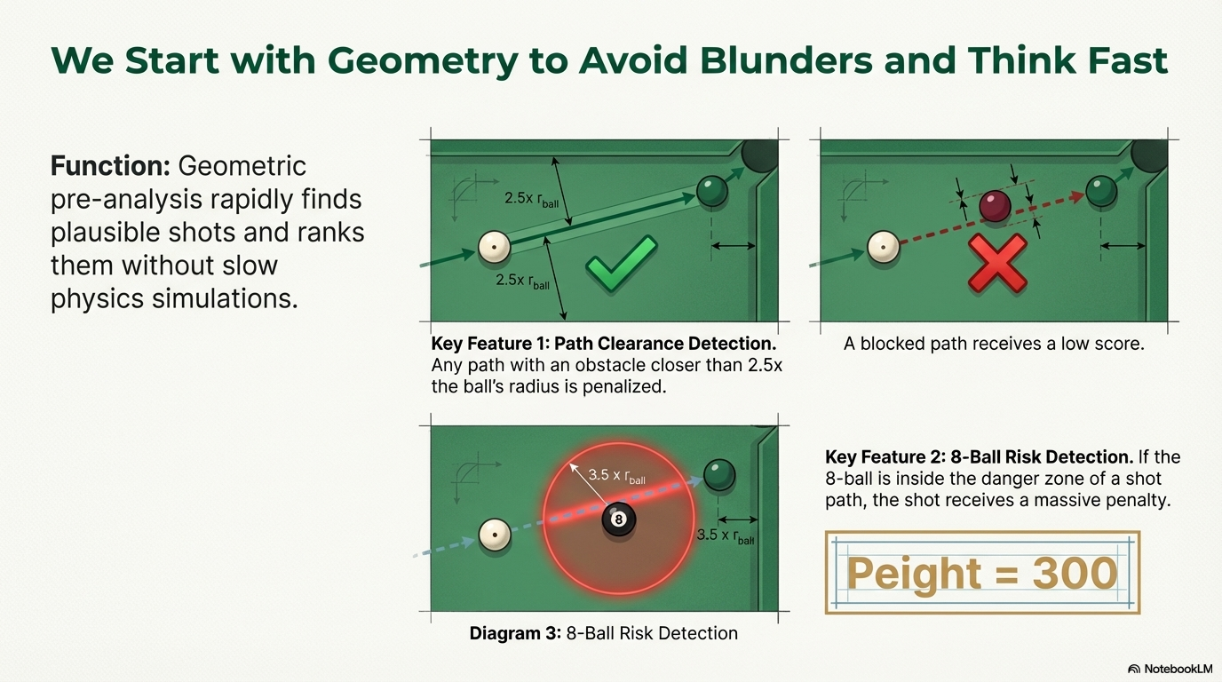

Slide 6
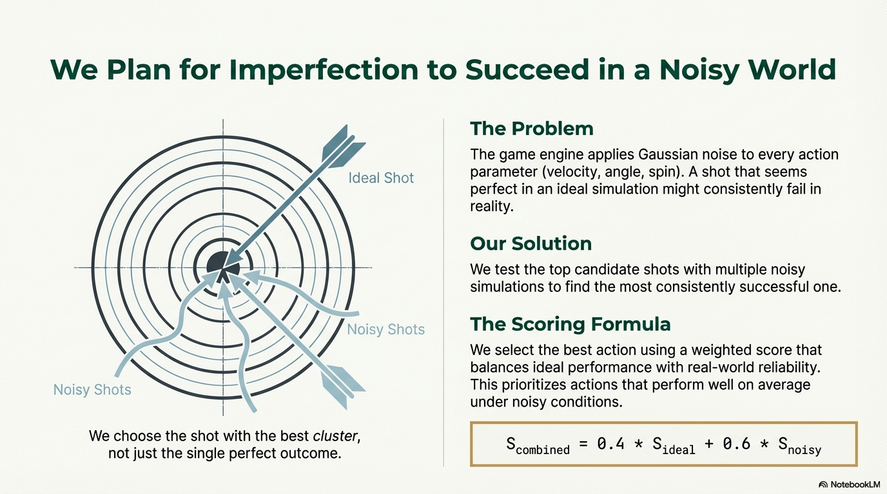

Slide 7
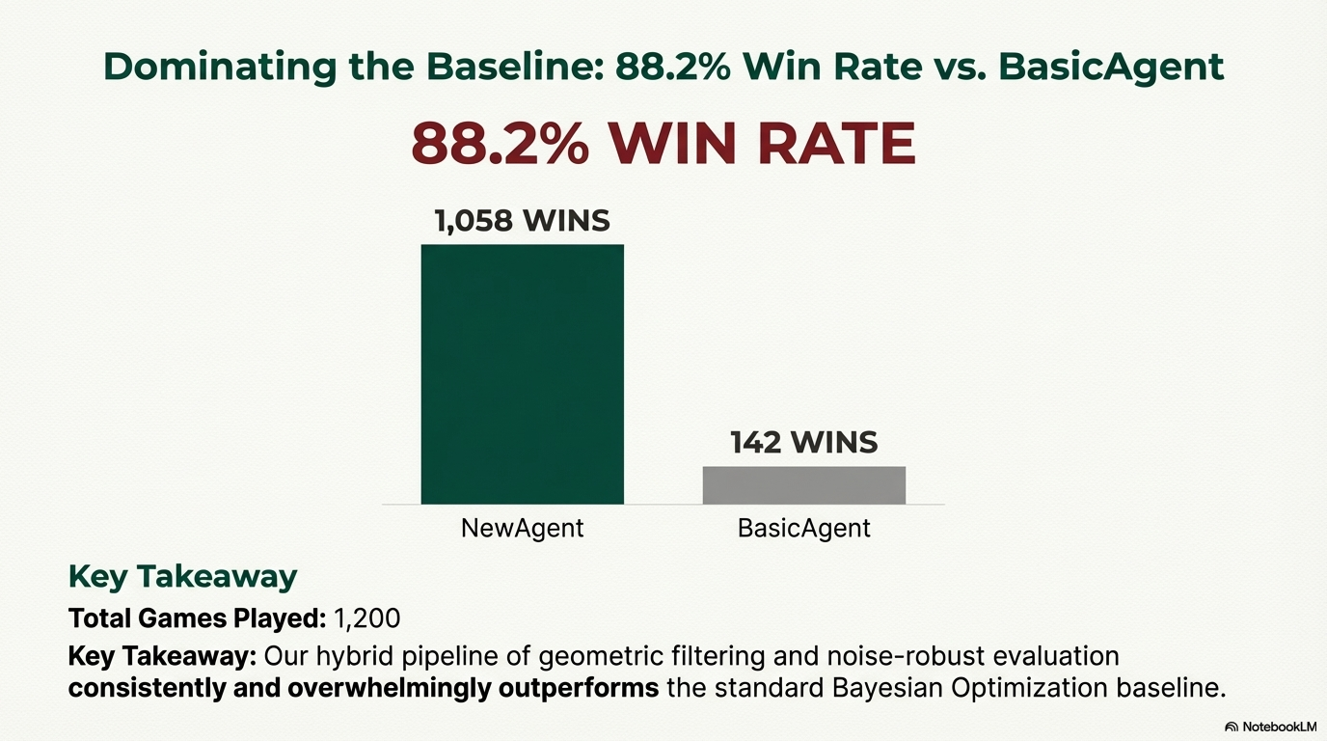
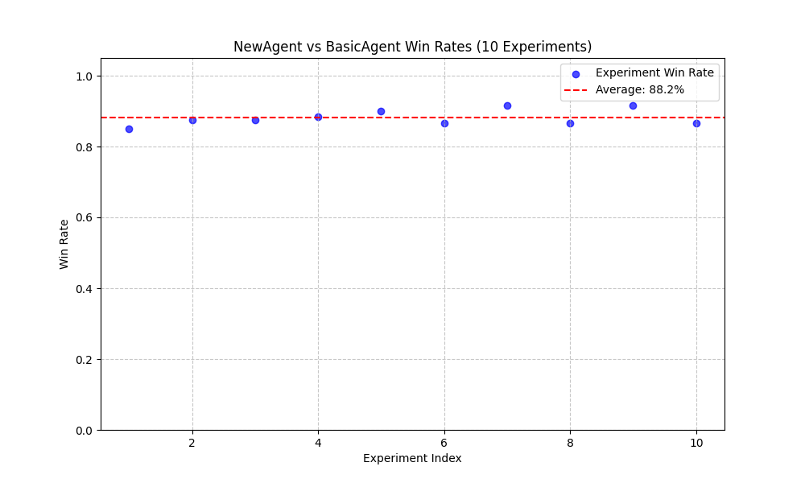
Total Games Played: 1,200
Key Takeaway: Our hybrid pipeline of geometric filtering and noise-robust evaluation consistently and overwhelmingly outperforms the standard Bayesian Optimization baseline.

Slide 8
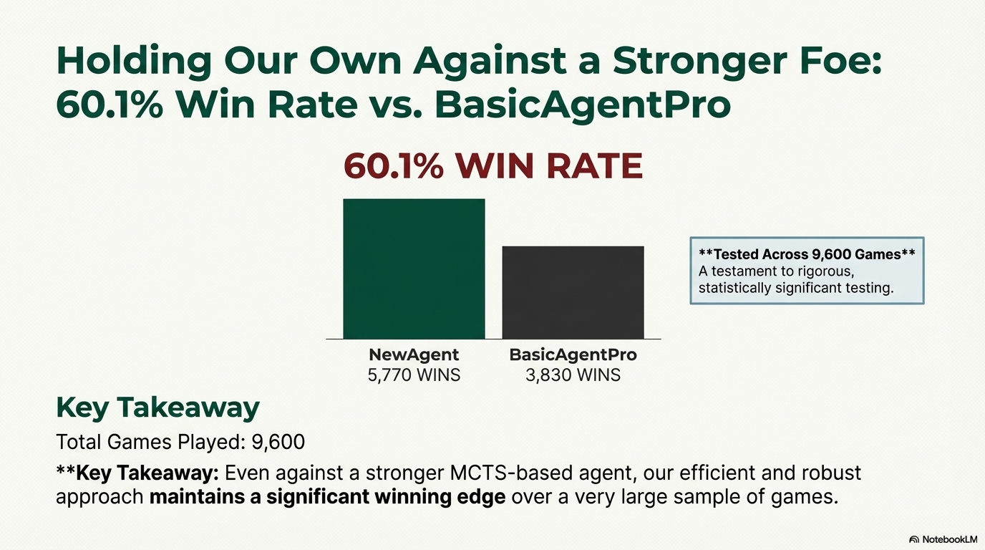
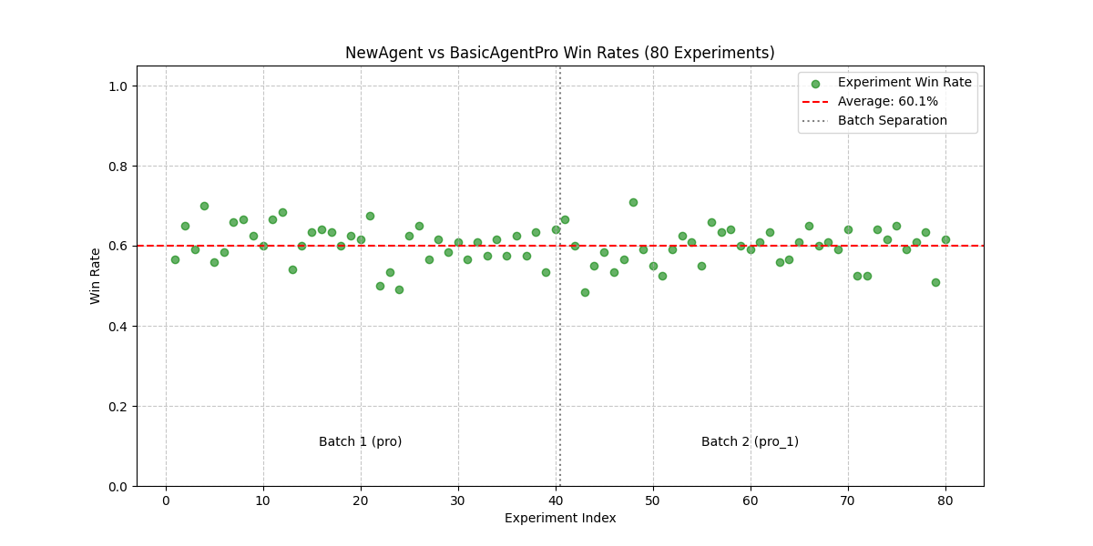
Tested Across 9,600 Games
A testament to rigorous, statistically significant testing.
Total Games Played: 9,600
Key Takeaway: Even against a stronger MCTS-based agent, our efficient and robust approach maintains a significant winning edge over a very large sample of games.

Slide 9
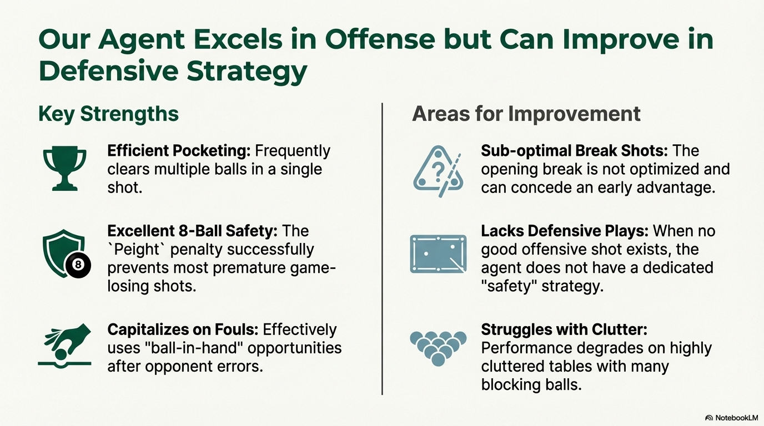

Slide 10
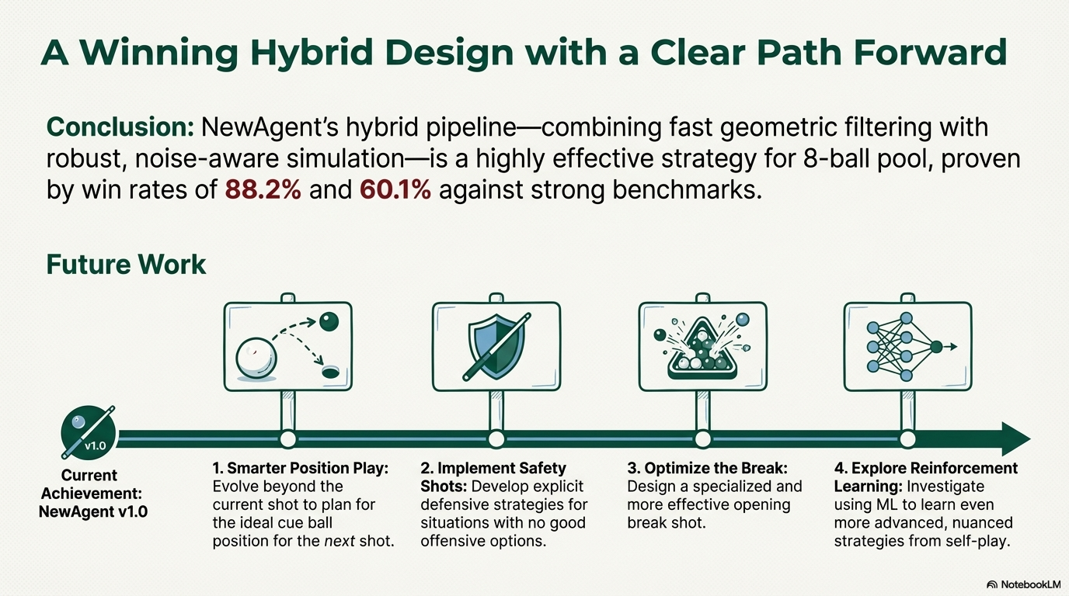

Slide 11
Thank you!
Q & A

